Slide 1
ORD-COORDINATED RESEARCH ON SARS-COV-2/COVID-19
Dial in (Main): (415) 655-0052
Dial in (Alt): (951) 266-6125
Access Code: 247-993-899
Slides in “Handout” Tab
Office of Research & Development
April 7, 2020

Slide 2
PRESENTERS (in order)
Rachel Ramoni, DMD, ScD – Chief Research and Development Officer (CRADO)
Grant Huang, MPH, PhD – Acting Deputy CRADO – Enterprise Optimization
Molly Klote, MD – Director, Office of Research Protections, Policy and Education
Victoria Davey, PhD, MPH, RN – Associate CRADO for Epidemiology and Public Health
2

Slide 3
PRESENTERS Cont’d (in order)
Theresa Gleason, PhD – Director, Clinical Science R&D
David Atkins, MD, MPH – Director, Health Services R&D
Holly Krull, PhD – Deputy Director, Biomedical Laboratory R&D
Tricia Dorn, PhD – Director, Rehabilitation R&D
Suma Muralidhar, PhD – Director, Million Veteran Program
3

Slide 4
OUTLINE
ORD COVID-19 Response Team Activities
Industry Partnerships / Access to Clinical Trials for Veterans & CSP studies
Regulatory activities for COVID-19 studies
VA interagency collaborations
ORD supported research
Clinical Science R&D
Health Services R&D
Biomedical Lab R&D
Rehabilitation R&D
Million Veteran Program
Q&A (through Chat Line)
4

Slide 5
COMMENTS FROM THE CHIEF RESEARCH AND DEVELOPMENT OFFICER
5

Slide 6
ORD COVID-19 RESPONSE TEAM COORDINATION
ORD is working regularly with VA partners to coordinate research activities
Pharmacy Benefits Management (Expanded access, industry trials)
Office of Informatics & Analytics (Standard data elements; National Surveillance Task Force & clinical data)
Public Health Surveillance and Research
Innovation Ecosystem (Industry partnerships)
Office of General Counsel / STAR; Office of Research Oversight; Privacy; Office of Information Technology
6

Slide 7
INFORMING ORD ABOUT COVID-19 RESEARCH
Information from field helps with communication & use of resources.
ORDCOVID19@va.gov
SharePoint site / data call on COVID-19 research activities
Notice of interest as trial site (through ACOS-R)
Information helps with:
VA Central IRB prioritization
OGC/STAR reviews & coordination with other VA offices
Communication with external partners
ORD COVID-19 Steering Committee review (2x / week)
A lot of new information is received daily
and tracked by ORD.
7

Slide 8
VA COVID-19 PORTFOLIO ANALYSIS
VA research categorized by:
Method – clinical trial, observational, data analysis
Strategy – treatment, diagnostic, prophylaxis
Patient type
Inpatient / outpatient
Early, severe, critically ill/ICU, convalescent
Sites
Locations, number/total
Input obtained from COVID-19 Steering Committee
8

Slide 9
INDUSTRY CLINICAL TRIALS & VA Cooperative Studies
9

Slide 10
ACCESS TO CLINICAL TRIALS FOR VETERANS
ORD initiative started in 2018
Goal: To streamline start-up process for high quality, multi-site industry clinical trials within VHA healthcare system
ORD’s Partnered Research Program
Central non-disclosure agreement – signed by CRADO
Work with sponsor on receiving protocol & distributing to interested parties
Work with VA non-profit corporations on multi-site CRADA
Coordinate with VA Central IRB
ORD is actively working with industry to provide info on
VA research capabilities, processes and VA sites
10

Slide 11
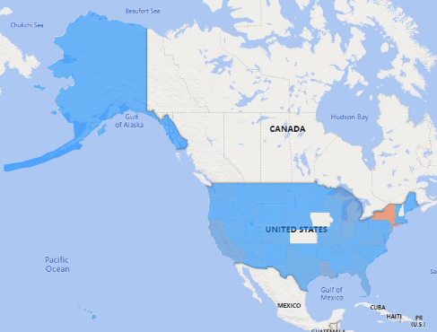
INPATIENT
11

Slide 12
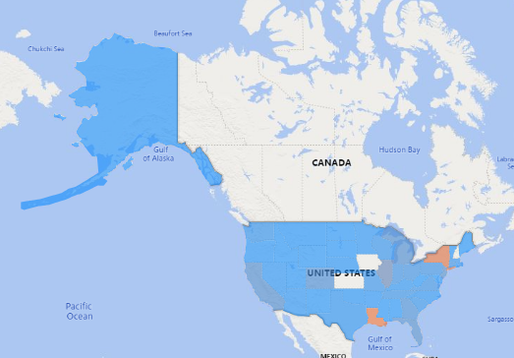
OUTPATIENT
12

Slide 13
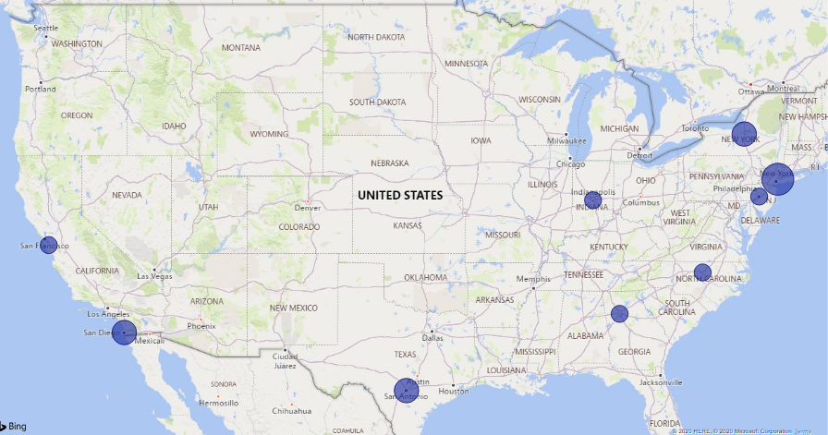
MAP OF CURRENT RESEARCH ACTIVITIES.
13

Slide 14
INDUSTRY-SPONSORED TRIALS FOR COVID-19
Gilead/remdesivir – model CRADA and other documents available;
1 VAMC enrolling; ORD has provided other sites to consider
Regeneron/Kevzara (IL-6 inhibitor) – agreement & process for commercial IRB established;
1 VAMC enrolling; ORD has provided other sites to consider
Roche/Actemra (Ph III-IL6 inhibitor) – work with CRO
1 VAMC enrolling; ORD has provided other sites to consider
11 other companies about trials
Information under non-disclosure agreement
VA sites indicating interest shared with sponsors
14

Slide 15
SITE SELECTION PROCESS
ORD submits list of interested sites & investigators to sponsor
Industry sponsor ultimately decides which sites to include
Key factors:
PI/site experience in clinical trials
Ability to start quickly – including IRB, CRADA & hiring
Patient population
Monitoring access / study compliance
Local infrastructure (e.g., pharmacy, clinical space, etc.)
VA non-profit corporation
15

Slide 16
VA COOPERATIVE STUDY #2027
Randomized, Placebo-Controlled Trial to Evaluate the Efficacy of Hydroxychloroquine to Prevent SARS-CoV-2 Infection in Exposed Persons
Study proponents: Sanjay Mehta, MD, Davey Smith, MD MAS VA San Diego HCS
CSP Coordinating Centers: West Haven, Albuquerque
LOI received Feb 2020; currently in planning
16

Slide 17
Regulatory UPDATES FOR VA RESEARCH on COVID-19
17

Slide 18
Research Regulatory
Webinars
https://www.research.va.gov/programs/orppe/education/webinars/default.cfm
(also on ORD COVID-19 SharePoint site)
FAQ documents
https://dvagov.sharepoint.com/sites/vacovhacomm/admin/projects/covid19/SitePages/ORD-Communications.aspx
New Biosafety FAQs with yesterday’s ORD Newsletter
VHA Telehealth Memo
18

Slide 19
Expanded Access
Convalescent plasma approved by FDA –
Emergency Use
https://www.fda.gov/vaccines-blood-biologics/investigational-new-drug-ind-or-device-exemption-ide-process-cber/investigational-covid-19-convalescent-plasma-emergency-inds
Expecting 3 treatment INDs to be announced
1 treatment IND has started under the Mayo clinic IRB
BARDA is paying for plasma
19
Notes:
Biomedical Advanced Research and Development Authority (BARDA), HHS

Slide 20
Expanded Access (cont)
Monoclonal Ab
Company is finalizing discussions with FDA
Treatment IND possible
20

Slide 21
IRBs
VA Central IRB
Ready and waiting for multisite protocols
Prepared for Ad hoc meetings
Commercial IRBs
MSAs with WIRB and Advarra
Can be used if VHA is not paying
No appearance that VHA is paying
You can have your site update its FWA and enter into an agreement now for future potential studies
https://www.research.va.gov/programs/orppe/ORD-IRB-Reliance-Request-Form.pdf
Any commercial IRB after vetting
Sponsor must choose the IRB
21

Slide 22
INTERAGENCY PARTNERSHIPS
22

Slide 23
VA Interagency Collaborations
Contributing to national efforts
Demonstrating VA’s research capabilities
Coordinating to
Fill in gaps
Avoid overlap
23

Slide 24
What is BARDA?
24

Slide 25
HHS Office of the Assistant Secretary for Preparedness and Response (ASPR): 4 missions
25

Slide 26
BARDA: Biomedical Advanced R & D Authority
Develops and procures of innovative medical countermeasures
Has flexible, nimble authorities
Uses multi-year advance funding
Employs public-private partnerships
In COVID-19 we advise and are advised by BARDA
26

Slide 27
BARDA: COVID-19 Response
BARDA COVID-19 Medical Countermeasures
Therapeutics Working Group
Diagnostics Working Group
Clinical Trials Working Group
Specimens and Samples Working Group
VA: Specimens for NIAID
VA: collaboration, review
VA: Return to Work
VA: collaboration, review
27

Slide 28
BARDA: COVID-19 Response
BARDA COVID-19 Medical Countermeasures
Therapeutics Working Group
Diagnostics Working Group
Clinical Trials Working Group
Specimens and Samples Working Group
VA: Specimens
for NIAID
VA: collaboration, review
VA: Return to Work
VA: collaboration, review
28

Slide 29
Specimens for NIAID
NIAID’s Vaccine Research Center distributes convalescent serum for vaccine, therapeutics research
VA helping collect specimens
Acting as a service, not part of research
We refer patients/assist patients with contacting NIAID
NIAID obtains phone consent
Blood shipped from VAMCS or
Home blood drawing contract in the works
Contact ORDCOVID19@va.gov for directions
29

Slide 30
Return to Work
Return to Work Project
Multiple Federal agencies working to determine when it is safe (immunologically) to return to work
VA involved
Determination of research questions
Sample acquisition
Review of diagnostic candidates
Field evaluation
Contact ORDCOVID19@va.gov if you have expertise and interest
30

Slide 31
DoD– EPICC-EID now underway with CSP Support
Epidemiology, Immunology and Clinical Characteristics of Emerging Infectious Diseases with Pandemic Potential (EPICC-EID)
Protocol activated during outbreaks of severe or potentially severe acute infections with pathogens of concern to public health—1st Activation
Multisite, longitudinal observational study in COVID-19 symptomatic
Collection of clinical specimens and data according to International Severe Acute Respiratory and Emerging Infection Consortium (ISARIC) network standards
PI Jennifer Lee, VA Palo Alto, co-PI Jennifer Ross, Seattle
31

Slide 32
Speaking of advice…
COVID-19 Steering Committee for ORD
Vincent Marconi Atlanta
Sheldon Brown Bronx
Robert Bonomo Cleveland
Chris Woods Durham
Jack Stapleton Iowa City
Mark Holodniy Palo Alto
Scott Duvall VINCI/Salt Lake City
Review ideas and proposals, advise on priorities, reality-check
32

Slide 33
COVID-19 ACTIVITIES AMONG THE ORD RESEARCH SERVICES
33

Slide 34
Coordinating COVID-19 Research Across ORD
At the level of ORD supported projects, there are multiple activities being coordinated; details will be summarized in the following slides.
Highlights:
Initial rapid response announcements from HS & CS
BLRD Announcement
Upcoming:
Program Announcement describing areas of interest across services is being developed that will lean into standing review cycles mechanisms:
RRD / HSRD for Summer 2020 review cycle
Service Directed Research for clinical trial support by CSRD
34

Slide 35
Program Announcement for COVID-19 Research
A Program Announcement will provide more details shortly and will be highlighting priority areas by service. Proposals will be reviewed in usual Merit Review cycles by special emphasis panels where appropriate; examples include:
HSRD: variations in organization of care, practice, outcomes; costs of care; impacts on staff; impacts on non ID outcomes for Summer SMRB.
RRD: Including a Special Emphasis Area in their Summer Merit Review RFA/FOA, to be posted this week. The emphasis is on physical, cognitive, and psychosocial disability and rehabilitation approaches following COVID-19 infection or social distancing.
35

Slide 36
Clinical Science R&D Service
Rapid Response Announcement; rolling deadline until July 1, 2020
Responsive vs Non-responsive
Review: priority topic, feasibility, timeline
Service Directed Research: clinical trials funded by CSRD
Use Letter of Intent for Trials to present rationale
Application for trials reviewed in special panels as needed
Example this week: Application under review
Program Announcement priorities for CSRD will include:
Trials proposing off-label or repurposed medications
Physical and mental health impacts of COVID-19
Screening; diagnosis
36

Slide 37
Biomedical Laboratory R&D Service
Applications should address issues related to the prevention and treatment of COVID-19 infection at the preclinical level. Proposals that focus on aspects unique to the Veteran population are encouraged.
Responsive applications include development of protective measures ranging from the production and testing of personal protective devices for use in VA facilities to development of vaccines, studies of small molecules or biologics as treatments for active disease (in vitro and/or in vivo studies), and studies of the role and modulation of immune responses that may contribute to the disease pathogenesis.
Respond to Parent RFA, BX 20-001
Research plan is limited to 9 pages
Budget is capped at 2 years and $165,000 per year
All 5/8 VA salaried investigators may apply
Application deadline is April 30
37

Slide 38
HSR&D Rapid Response Projects
Jumpstart research efforts by supporting work related to COVID-19
Planning projects (“preparatory to research activities”); short-term pilots; data analysis projects; modifications to existing projects.
Timeline, Review, & Award
First submissions were due Monday, April 6 (decisions announced by May 1)
Subsequent applications reviewed on a rolling basis through July 1
Application (submitted by PI’S VA Research Office)
Concept paper (3 pages)
Summary budget table & budget justification
No minimum or maximum budget BUT funds should be expendable within 9 months (estimate $25,000 - $100,00)
Discourage TBH staff
Notes:
Projects are NOT subject to administrative hold/stand down
Projects must not interfere with the mission critical work of VA clinical and operations partners in their response to COVID-19
Additional Information
RFA available at: https://www.hsrd.research.va.gov/funding/Rapid-Response-Projects_COVID19.pdf
Direct questions to: vhacoordcoin@va.gov
38

Slide 39
Evidence Synthesis Program (ESP)
Ultra-Rapid Reviews
Collaborating with WHO to produce reviews on urgent topics within a few days of request
Topics include:
Does corticosteroid therapy improve or exacerbate COVID-19 outcomes?
Do common hypertension medications (ACE inhibitors, angiotensin receptor blockers) increase risk of contracting COVID-19 and/or increase severity of the disease?
Rapid Commentary on New Research
Producing commentary on new publications and pre-prints at the request of clinical and operational leadership, including the heads of Emergency Medicine, Critical Care, and Hospital Medicine
Monitoring Changes in Clinical Guidance
Reporting to clinical and operational leadership on changes in guidance from medical societies, including: American Board of Emergency Medicine, American College of Emergency Physicians, Society of Critical Care Medicine
39

Slide 40
RR&D Special Emphasis Area* in COVID-19 Research:
Studies on the impact of COVID-19 on Veterans’ physical, sensory, cognitive and psychosocial function by:
Understanding the onset of, severity and duration, and recovery from disability in Veterans following COVID-19 that considers the influence of comorbidities (e.g., pre-existing pulmonary, cardiometabolic, oncologic, mental health, immunological or other disorders, etc.) and other risk factors (e.g., age, living conditions, environmental exposures, etc.);
Revealing late or delayed effects of secondary conditions related to COVID-19 infections on impairment and disability;
Examining COVID-19-specific rehabilitation interventions and responses to treatment; or
Determining the impact of social distancing on functional status in healthy, disabled and at-risk Veterans (e.g., substance use and mental health disorders, homelessness).
*Summer Merit Review Parent (I01) RFA, posting week of April 6, 2020
40

Slide 41
Contacts by Service
We will coordinate the ORD funded COVID-19 research portfolio, including high degree of integration with the COVID-19 steering committee, for priority setting and coverage. Questions regarding service-level priorities and announcements may be sent as follows:
BLRD/CSRD: VHABLRD-CSRD@va.gov
HSRD: Vhacoordcoin@va.gov
RRD: rrdreviews@va.gov
41

Slide 42
Million Veteran Program (MVP)
Developing a new COVID-19 questionnaire for all MVP enrollees; will be available for VA-wide use
Contributing to centralized efforts for COVID-19 phenotype definition (coordinated with VINCI, CSP, Office of Public Health Surveillance and Research, Office of Health Informatics)
MVP Executive Committee developing high priority, near term research plan; plan to integrate more longer-term research into existing ORD-wide Service RFAs
Leveraging partnership with the Department of Energy
42

Slide 43
QUESTIONS OR NEED HELP?
Email:
ORDCOVID19@va.gov
43

Slide 44
THANK YOU AND QUESTIONS
44

Slide 45
AVAILABILITY OF RECORDING
A recording of this session and any associated handouts will be available on ORPP&E’s Education and Training website approximately one week post-webinar.
https://www.research.va.gov/programs/orppe/education/webinars/archives.cfm
45

